Slide 1

Hello
Welcome Yaseen to ICDL Cousre at Discovery Academy

Slide 2
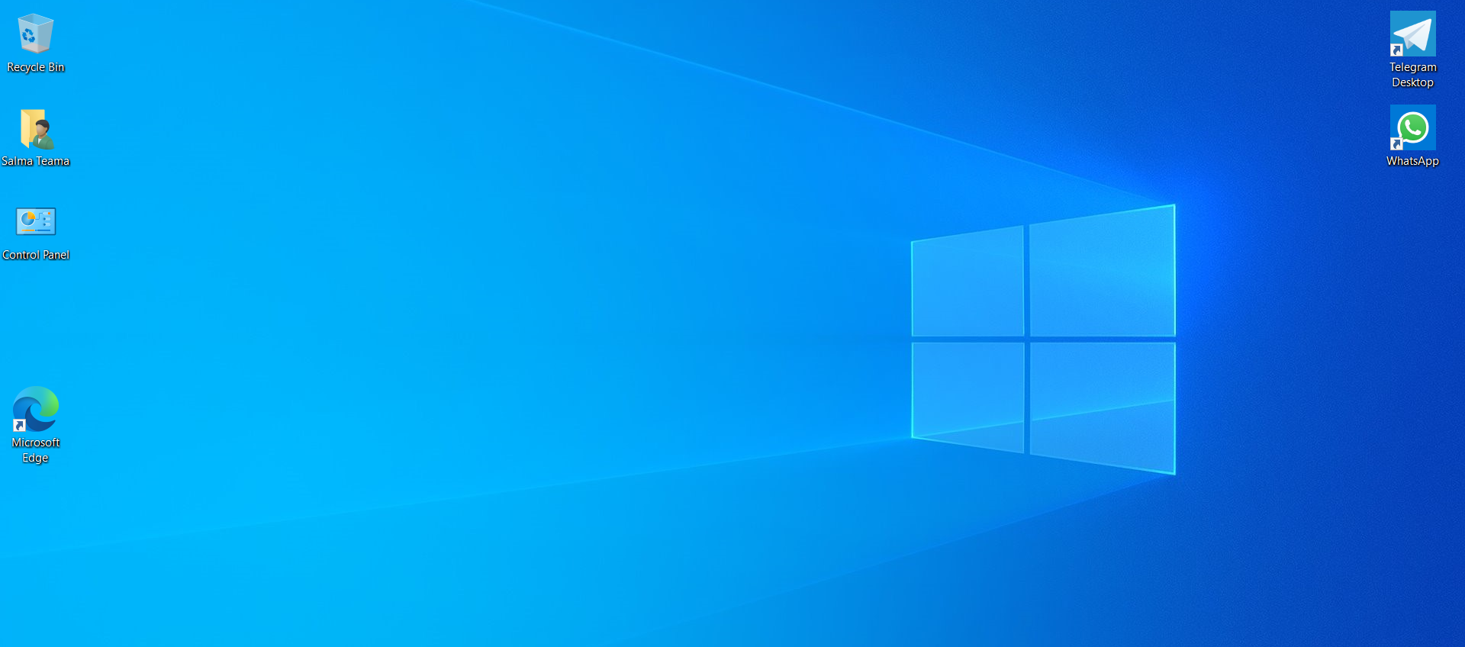
ghfjfgvjkgh

